Slide 1

SMART ASSISTANT

Slide 2
CONTENT
INTRODUCTION
COMPONENTS USED
METHODOLOGY
MODULE IMPLEMENTATION

Slide 3
INTRODUCTION
A Voice Command System essentially means a system that processes voice as an input, decodes or understands the meaning of that input processes it and generates an appropriate voice output. Any voice command system need three basic components which are speech to text converter, query processor and a text to speech converter. Voice has been a very integral part of communication nowadays. Since, it is faster to process sound and voices than to process written text, hence voice command systems are omnipresent in computer devices.

Slide 4
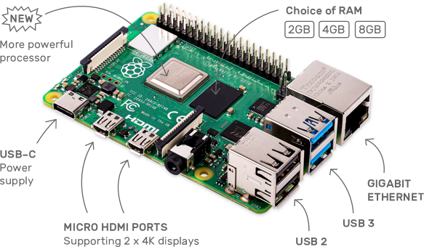
RASPBERRY PI
Raspberry Pi is a series of low-cost, single-board computers developed by the Raspberry Pi Foundation. These small computers are designed to be accessible to beginners and advanced users alike, and are capable of running a variety of operating systems, including Linux and Windows.

Slide 5
OTHER COMPONENTS
Microphone
Microphone is used to take the audio input of the sound. This audio input when further passed through the system would be searched for keywords. These keywords are essential for the functioning of the voice command system as our modules work on the essence of searching for keywords and giving output by matching keywords.
Speaker
Speakers, once the query put forward by the user has transmitted via the speakers which are connected to the audio been processed, the text output of that query is converted to jack of the Raspberry Pi. Speech using the online text to speech converter. Now this speech which is the audio output is sent to the user using the speakers which are running on audio out.
Monitor
Monitor or HDMI display provides you with the information about different tasks running on your system and you can analyse your CPU usage on your system screen if you achieve success in having it installed on your Raspberry Pi device.
Help in displaying the action performed using graphic commands like webpage.

Slide 6
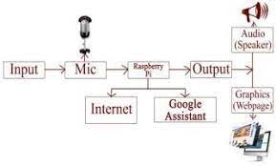
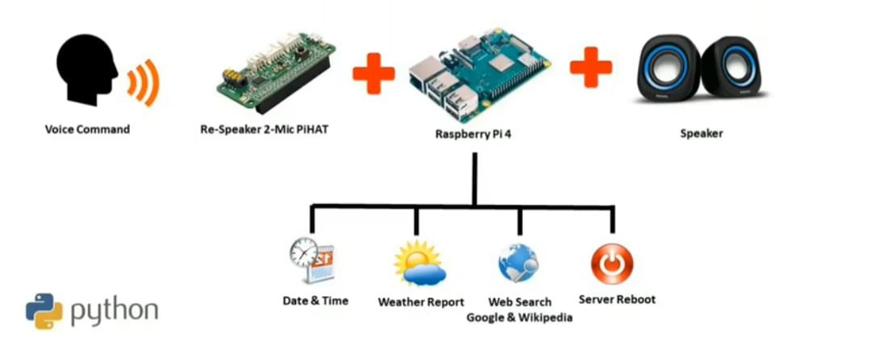
METHODOLOGY

Slide 7
MODULE IMPLEMENTATION
Speech To Text Engine:
(AVS) is a Speech-To-Text (STT) engine which is used to convert the commands given by the user in audio input to text form, so that these commands can be interpreted by the modules properly. To use (AVS) engine, an application has to be created in the Amazon developers console and the generated API key has to be used to access the speech engine. It requires continuous internet connection as data is sent over the Amazon servers.
Text To Speech Engine:
(AVS) is a Text-To-Speech (TTS) engine is used to version of the text in a computer document, such as a help file or a Web page. TTS can enable the reading of computer display information for the visually challenged person, or may simply be used to augment the reading of a text message. To use (AVS) engine, an application has to be created in the Amazon developers console and the generated API key has to be used to access the speech engine. It requires continuous internet connection as data is sent over the Amazon servers.

Slide 8
Query Processor:
The Voice Command System has a module for query processing which works in general like many query processors do. That means, taking the input from the users, searching for relevant outputs and then presenting the user with the appropriate output. In this system we are using the site wolfram alpha as the source for implementing query processing in the system. The queries that can be passed to this module include retrieving information about famous personalities, simple mathematical calculations, description of any general object etc.
Wikipedia:
This module works on the keyword of wiki. The system asks for what you would like to learn about. Then the request is made to the Wikipedia API for the required query. It generates the summary of the information regarding the query and the data is output through the microphone to the listener in audio form. In case of failure, the error message is generated saying unable to reach dictionary of wiki.
Weather:
This module tells the user about the weather conditions of the location whose station identifier is specified in the profile of the user. This module can be executed by using the keyword weather. The weather information is taken from the weather underground service which includes the details of temperature, wind speed and di-rection etc.

Slide 9
CONCLUSION
Smart assistants, also known as virtual assistants, are intelligent software programs that can perform tasks or services for users through voice commands or text-based interactions. They are designed to make our lives easier by providing quick access to information, helping us with tasks, and controlling our smart home devices.
Some popular examples of smart assistants include Amazon Alexa, Google Assistant, Apple Siri, and Microsoft Cortana. These assistants use natural language processing, machine learning, and artificial intelligence technologies to understand user requests and provide relevant responses.
While smart assistants offer many benefits, including convenience and efficiency, they also raise concerns about privacy and data security. Users should be aware of the data that is collected and how it is used by the companies that provide these services.
Overall, smart assistants are becoming increasingly integrated into our daily lives and are likely to continue to evolve and improve in the future, making them an important technology to watch.

